Slide 1
Bandwidth and Packet Type Detection Schemes for 40-50GHz Millimeter Wave Communication Systems
Authors:
Frank Hsu (MediaTek)

Slide 2
Introduction
In IEEE 802.11aj specifications, there are three PHY types, control PHY, single carrier PHY, and OFDM PHY
Also, transmission bandwidth can be in 540MHz channel or in 1080MHz channel
This proposal proposes a preamble design for auto-detection of bandwidth and packet type
Frank Hsu (MediaTek)

Slide 3
Motivations
In 45 GHz systems, there are multiple transmission schemes with three different packet formats and two kinds of bandwidth
Why bandwidth auto-detection in preamble?
RX can perform channel estimation on only the occupied bandwidth other than the maximum transmission bandwidth
Also, especially for single carrier packets, since there are no other training fields allowing RX to update channel estimation for different bandwidth
Why packet format auto-detection in preamble?
With packet type knowledge before channel estimation and PHY header decoding, RX does NOT have to perform parallel decoding for multiple possible packet formats
Frank Hsu (MediaTek)

Slide 4
Preamble Design (1/3)
There are five possible transmission schemes, including
Control PHY transmission only uses 540 MHz primary channel for simple interoperability.
SC and OFDM both can use 540 MHz or 1080 MHz
We propose to utilize different polarizations of ZCZ 256 (Z256) sequences in preamble, RX can do auto-detection of packet types and bandwidth
Frank Hsu (MediaTek)

Slide 5
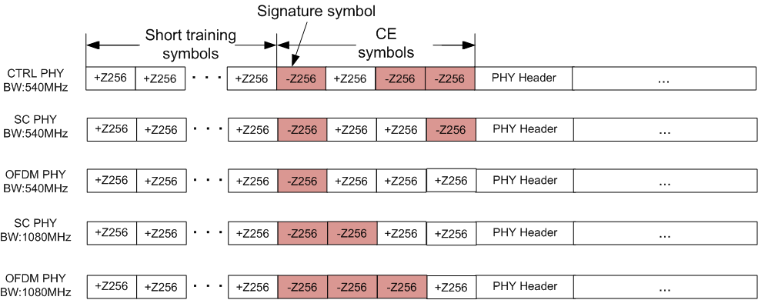
Preamble Design (2/3)
Signature symbol sets the boundary for starting BW and packet type detection
At lest two repetitions in CEF for better channel estimation
Frank Hsu (MediaTek)

Slide 6
Preamble Design (3/3)
The following sign patterns from CE symbols are used for bandwidth and packet type detection
The first sign pattern
indicates the BW
The second and third signs
indicate the packet type
Pattern | Channel BW | Packet Type
- - + | 540 MHz | Control PHY
- + - | 540 MHz | SC PHY
- + + | 540 MHz | OFDM PHY
+ - + | 1080 MHZ | SC PHY
+ + + | 1080 MHz | OFDM PHY
Frank Hsu (MediaTek)

Slide 7
Simulations
Correct detection includes
Signature symbol detection
Bandwidth detection
Packet format detection
Simulation setup
PHY type: Control PHY, SC 540MHz, OFDM 540MHz, SC 1080MHz, OFDM 1080MHz
Channel: AWGN
CFO: 0 ppm, +/- 5 ppm, +/- 10 ppm
Frank Hsu (MediaTek)

Slide 8
AWGN Simulation Results (1/5)
Detection error rate: AWGN & CFO 0 ppm
PHY Type | SNR (dB)
Ctrl | -10.4
SC540 | -10.5
OFDM540 | -10.3
SC1080 | -10.5
OFDM1080 | -10.4
10⁻³
Frank Hsu (MediaTek)

Slide 9
AWGN Simulation Results (2/5)
Detection error rate: AWGN & CFO 5 ppm
PHY Type | SNR (dB)
Ctrl | -9.8
SC540 | -9.6
OFDM540 | -9.7
SC1080 | -9.7
OFDM1080 | -9.7
10⁻³
10⁻³
Frank Hsu (MediaTek)

Slide 10
AWGN Simulation Results (3/5)
Detection error rate: AWGN & CFO -5 ppm
PHY Type | SNR (dB)
Ctrl | -9.6
SC540 | -9.6
OFDM540 | -9.5
SC1080 | -9.5
OFDM1080 | -9.8
10⁻³
10⁻³
Frank Hsu (MediaTek)

Slide 11
AWGN Simulation Results (4/5)
Detection error rate: AWGN & CFO 10 ppm
PHY Type | SNR (dB)
Ctrl | -9.3
SC540 | -9.3
OFDM540 | -9.3
SC1080 | -9.4
OFDM1080 | -9.2
10⁻³
10⁻³
Frank Hsu (MediaTek)

Slide 12
AWGN Simulation Results (5/5)
Detection error rate: AWGN & CFO -10 ppm
PHY Type | SNR (dB)
Ctrl | -9.3
SC540 | -9.3
OFDM540 | -9.4
SC1080 | -9.2
OFDM1080 | -9.3
10⁻³
10⁻³
Frank Hsu (MediaTek)

Slide 13
AWGN Performance Summary
Detection SNR @ 10⁻³ error rate
Comments
In general, when doing signature symbol detection, CFO has been compensated within 10 ppm or less
10 ppm CFO only introduces up to 1.3 dB loss
The detection capability is around -9 dB and fits for current 11aj 45 GHz specs.
 | 0 ppm | 5 ppm | -5 ppm | 10 ppm | -10 ppm
Ctrl | -10.4 | -9.8 | -9.6 | -9.3 | -9.3
SC540 | -10.5 | -9.6 | -9.6 | -9.3 | -9.3
OFDM540 | -10.3 | -9.7 | -9.5 | -9.3 | -9.4
SC1080 | -10.5 | -9.7 | -9.5 | -9.4 | -9.2
OFDM1080 | -10.4 | -9.7 | -9.8 | -9.2 | -9.3
Frank Hsu (MediaTek)

Slide 14
Summary
A preamble design is proposed for packet type and bandwidth auto-detection
Simulations show that detection performance fits current 11aj specification requirements
Frank Hsu (MediaTek)

Slide 15
References
[1] 11-14-1363-00-00aj-preamble-sequence-for-802-11aj-45ghz
[2] 11-14-0807-01-00aj-ldpc-coding-for-45ghz
[3] 11-15-0707-00-00aj-complete-proposal-for-IEEE-802.11aj (45 GHz)
Frank Hsu (MediaTek)

Slide 16
May 2015
BACKUP
Slide 16
Frank Hsu (MediaTek)

Slide 17
AWGN Simulation Results
Detection error rate: AWGN & CFO 20 ppm
PHY Type | SNR (dB)
Ctrl | -7.8
SC540 | -7.6
OFDM540 | -7.7
SC1080 | -7.7
OFDM1080 | -7.7
10⁻³
10⁻³
Frank Hsu (MediaTek)

Slide 18
AWGN Simulation Results
Detection error rate: AWGN & CFO -20 ppm
PHY Type | SNR (dB)
Ctrl | -7.9
SC540 | -7.7
OFDM540 | -7.9
SC1080 | -7.7
OFDM1080 | -7.8
10⁻³
10⁻³
Frank Hsu (MediaTek)

Slide 19
Exp 4ns Simulation Results
Detection error rate: Exp 4ns & CFO 0 ppm
PHY Type | SNR (dB)
Ctrl | -10.7
SC540 | -10.4
OFDM540 | -10.5
SC1080 | -10.6
OFDM1080 | -10.7
10⁻²
Frank Hsu (MediaTek)

Slide 20
Exp 10ns Simulation Results
Detection error rate: Exp 10ns & CFO 0 ppm
PHY Type | SNR (dB)
Ctrl | -9.4
SC540 | -9.7
OFDM540 | -9.7
SC1080 | -9.4
OFDM1080 | -9.4
10⁻²
Frank Hsu (MediaTek)

Slide 21
Exp 20ns Simulation Results
Detection error rate: Exp 20ns & CFO 0 ppm
PHY Type | SNR (dB)
Ctrl | -8.2
SC540 | -8.3
OFDM540 | -8.2
SC1080 | -7.9
OFDM1080 | -8.5
10⁻²
Frank Hsu (MediaTek)

Slide 22
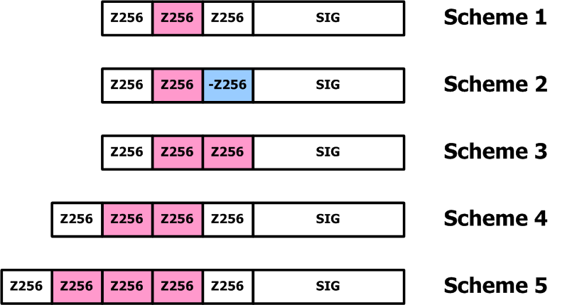
CE Schemes
May 2015
Five CE schemes
Colored Z256s are taken to estimate the channel
Scheme | CEF Sign Sequence
1 | +
2 | + -
3 | + +
4 | + +
5 | + + +
Slide 22
Frank Hsu (MediaTek)

Slide 23
Simulation Setup
May 2015
Packet Type/BW: SC 540 MHz
Packet Size: 1050 bytes
MCS: BPSK and LDPC 1/2
Channel: AWGN, Exp 4ns, Exp 10ns
5 CE schemes
Slide 23
Frank Hsu (MediaTek)

Slide 24
AWGN
May 2015
Scheme | SNR @10⁻¹ PER
1 | 1.29
2 | 1.29
3 | 1.29
4 | 1.28
5 | 1.28
Slide 24
Frank Hsu (MediaTek)

Slide 25
Exp 4ns
May 2015
Scheme | SNR @10⁻¹ PER
1 | 3.13
2 | 3.09
3 | 3.07
4 | 3.07
5 | 3.05
Slide 25

Slide 26
Exp 10ns
May 2015
Scheme | SNR @10⁻¹ PER
1 | 3.73
2 | 3.45
3 | 3.41
4 | 3.47
5 | 3.42
Slide 26
Frank Hsu (MediaTek)

Slide 27
Comments
May 2015
For short delay spread channels, AWGN And Exp 4ns, CE of all schemes has enough accuracy (required SNRs are within 0.1 dB difference)
For long delay spread channels, schemes 2 and scheme 3 CE provides enough accuracy, and adding more Z256 sequences provides little performance gain
Sign inversion of Z256 sequences does NOT cause any significant performance loss
Slide 27
Frank Hsu (MediaTek)

